Slide 1

Data Mining
Jitendra Soni
Notes:
The slides for this text are organized into several modules. Each lecture contains about enough material for a 1.25 hour class period. (The time estimate is very approximate--it will vary with the instructor, and lectures also differ in length; so use this as a rough guideline.) This lecture is the first of two in Module (1).
Module (1): Introduction (DBMS, Relational Model)
Module (2): Storage and File Organizations (Disks, Buffering, Indexes)
Module (3): Database Concepts (Relational Queries, DDL/ICs, Views and Security)
Module (4): Relational Implementation (Query Evaluation, Optimization)
Module (5): Database Design (ER Model, Normalization, Physical Design, Tuning)
Module (6): Transaction Processing (Concurrency Control, Recovery)
Module (7): Advanced Topics

Slide 2
What Is Data Mining?
Data mining refers to extracting or mining knowledge from large amounts of data.
It is the computational process of discovering patterns in large data sets involving methods at the intersection of artificial intelligence, machine learning, statistics, and database systems.

Slide 3
The overall goal of the data mining process is to extract information from a data set and transform it into an understandable structure for further use.
The key properties of data mining are
Automatic discovery of patterns
Prediction of likely outcomes
Creation of actionable information
Focus on large datasets and databases

Slide 4
The Scope of Data Mining
1-Automated prediction of trends and behaviors.
Data mining automates the process of finding predictive information in large databases.
A typical example of a predictive problem is targeted marketing.
Data mining uses data on past promotional mailings to identify the targets most likely to maximize return on investment in future mailings.
Other predictive problems include forecasting bankruptcy and other forms of default, and identifying segments of a population likely to respond similarly to given events.

Slide 5
2-Automated discovery of previously unknown patterns.
Data mining tools sweep through databases and identify previously hidden patterns in one step.
An example of pattern discovery is the analysis of retail sales data to identify seemingly unrelated products that are often purchased together.
Other pattern discovery problems include detecting fraudulent credit card transactions
and identifying anomalous data that could represent data entry keying errors.

Slide 6
Tasks of Data Mining
Association rule learning (Dependency modelling) – Searches for relationships between variables.
For example a supermarket might gather data on customer purchasing habits. Using association rule learning, the supermarket can determine which products are frequently bought together and use this information for marketing purposes. This is sometimes referred to as market basket analysis.

Slide 7
Anomaly detection (Outlier/change/deviation detection) – The identification of unusual data records, that might be interesting or data errors that require further investigation.
Clustering – is the task of discovering groups and structures in the data that are in some way or another "similar", without using known structures in the data.

Slide 8
Classification – is the task of generalizing known structure to apply to new data. For example, an e-mail program might attempt to classify an e-mail as "legitimate" or as "spam".
Regression – attempts to find a function which models the data with the least error.
Summarization – providing a more compact representation of the data set, including visualization and report generation.

Slide 9
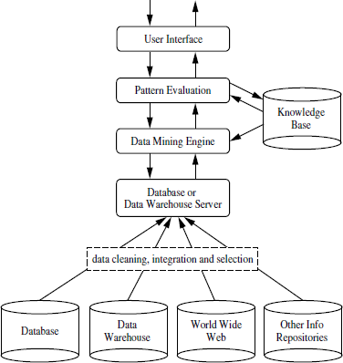
Architecture of Data Mining

Slide 10
major components of data mining system
1. Knowledge Base:
This is the domain knowledge that is used to guide the search or evaluate the interestingness of resulting patterns.
Such knowledge can include concept hierarchies used to organize attributes or attribute values into different levels of abstraction. Knowledge such as user beliefs, which can be used to assess a pattern’s interestingness based on its unexpectedness, may also be included. Other examples of domain knowledge are additional interestingness constraints or thresholds, and metadata (e.g., describing data from multiple heterogeneous sources).

Slide 11
2-Data Mining Engine:
This is essential to the data mining system and ideally consists of a set of functional modules for tasks such as characterization, association and correlation analysis, classification, prediction, cluster analysis, outlier analysis, and evolution analysis.

Slide 12
3-Pattern Evaluation Module:
This component typically employs interestingness measures interacts with the data mining modules so as to focus the search toward interesting patterns.
It may use interestingness thresholds to filter out discovered patterns. Alternatively, the pattern evaluation module may be integrated with the mining module, depending on the implementation of the data mining method used.
For efficient data mining, it is highly recommended to push the evaluation of pattern interestingness as deep as possible into the mining process so as to confine the search to only the interesting patterns.

Slide 13
4-User interface:
This module communicates between users and the data mining system, allowing the user to interact with the system by specifying a data mining query or task, providing information to help focus the search, and performing exploratory data mining based on the intermediate data mining results. In addition, this component allows the user to browse database and data warehouse schemas or data structures, evaluate mined patterns, and visualize the patterns in different forms.

Slide 14
Data Mining Process:
Data Mining process--discovering various models, summaries, and derived values from a given collection of data.

Slide 15
The general experimental procedure adapted to data-mining problems involves the following steps:
1-State the problem and formulate the hypothesis
Most data-based modeling studies are performed in a particular application domain. Hence, domain-specific knowledge and experience are usually necessary in order to come up with a meaningful problem statement.
Unfortunately, many application studies tend to focus on the data-mining technique at the expense of a clear problem statement. In this step, a modeler usually specifies a set of variables for the unknown dependency and, if possible, a general form of this dependency as an initial hypothesis. There may be several hypotheses formulated for a single problem at this stage. The first step requires the combined expertise of an application domain and a data-mining model. In practice, it usually means a close interaction between the data-mining expert and the application expert. In successful data-mining applications, this cooperation does not stop in the initial phase; it continues during the entire data-mining process.

Slide 16
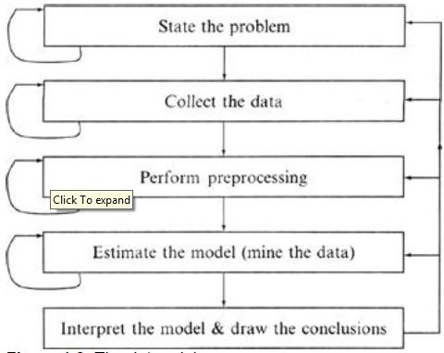
The Data mining Process

Slide 17
Collect the data
This step is concerned with how the data are generated and collected. In general, there are two distinct possibilities. The first is when the data-generation process is under the control of an expert (modeler): this approach is known as a designed experiment.
The second possibility is when the expert cannot influence the data- generation process: this is known as the observational approach. An observational setting, namely, random data generation, is assumed in most data-mining applications. Typically, the sampling distribution is completely unknown after data are collected, or it is partially and implicitly given in the data-collection procedure. It is very important, however, to understand how data collection affects its theoretical distribution, since such a priori knowledge can be very useful for modeling and, later, for the final interpretation of results. Also, it is important to make sure that the data used for estimating a model and the data used later for testing and applying a model come from the same, unknown, sampling distribution. If this is not the case, the estimated model cannot be successfully used in a final application of the results.

Slide 18
3. Preprocessing the data
In the observational setting, data are usually "collected" from the existing databses, data warehouses, and data marts.
Data preprocessing usually includes at least two common tasks:

Slide 19
i. Outlier detection (and removal) – Outliers are unusual data values that are not consistent with most observations. Commonly, outliers result from measurement errors, coding and recording errors, and, sometimes, are natural, abnormal values. Such non representative samples can seriously affect the model produced later. There are two strategies for dealing with outliers:
Detect and eventually remove outliers as a part of the preprocessing phase, or
Develop robust modeling methods that are insensitive to outliers.
ii. Scaling, encoding, and selecting features – Data preprocessing includes several steps such as variable scaling and different types of encoding. For example, one feature with the range [0, 1] and the other with the range [−100, 1000] will not have the same weights in the applied technique; they will also influence the final data-mining results differently. Therefore, it is recommended to scale them and bring both features to the same weight for further analysis.

Slide 20
Also, application-specific encoding methods usually achieve dimensionality reduction by providing a smaller number of informative features for subsequent data modeling.
These two classes of preprocessing tasks are only illustrative examples of a large spectrum of preprocessing activities in a data-mining process.
Data-preprocessing steps should not be considered completely independent from other data-mining phases. In every iteration of the data-mining process, all activities, together, could define new and improved data sets for subsequent iterations. Generally, a good preprocessing method provides an optimal representation for a data-mining technique by incorporating a priori knowledge in the form of application-specific scaling and encoding.

Slide 21
4-Estimate the model
The selection and implementation of the appropriate data-mining technique is the main task in this phase. This process is not straightforward; usually, in practice, the implementation is based on several models, and selecting the best one is an additional task.
analyze specific techniques that are applied to perform a successful learning process from data and to develop an appropriate model.

Slide 22
5-Interpret the model and draw conclusions
In most cases, data-mining models should help in decision making. Hence, such models need to be interpretable in order to be useful because humans are not likely to base their decisions on complex "black-box" models. Note that the goals of accuracy of the model and accuracy of its interpretation are somewhat contradictory. Usually, simple models are more interpretable, but they are also less accurate. Modern data-mining methods are expected to yield highly accurate results using high dimensional models. The problem of interpreting these models, also very important, is considered a separate task, with specific techniques to validate the results. A user does not want hundreds of pages of numeric results. He does not understand them; he cannot summarize, interpret, and use them for successful decision making.

Slide 23


Slide 24
Classification of Data mining Systems:
The data mining system can be classified according to the following criteria
Database Technology
Statistics
Machine Learning
Information Science
Visualization
Other Disciplines

Slide 25
Some Other Classification Criteria:
Classification according to kind of databases mined
Classification according to kind of knowledge mined
Classification according to kinds of techniques utilized
Classification according to applications adapted

Slide 26
1-Classification according to kind of databases mined
We can classify the data mining system according to kind of databases mined. Database system can be classified according to different criteria such as data models, types of data etc. And the data mining system can be classified accordingly. For example if we classify the database according to data model then we may have a relational, transactional, object- relational, or data warehouse mining system.

Slide 27
2-Classification according to kind of knowledge mined
We can classify the data mining system according to kind of knowledge mined. It is means data mining system are classified on the basis of functionalities such as:-
Characterization
Discrimination
Association and Correlation Analysis
Classification
Prediction Clustering
Outlier Analysis
Evolution Analysis

Slide 28
3-Classification according to kinds of techniques utilized
We can classify the data mining system according to kind of techniques used.
We can describes these techniques according to degree of user interaction involved or the methods of analysis employed.

Slide 29
4-Classification according to applications adapted
We can classify the data mining system according to application adapted. These applications are as follows:
Finance
Telecommunications
DNA
Stock Markets
E-mail

Slide 30
Major Issues In Data Mining:
Mining different kinds of knowledge in databases. - The need of different users is not the same. And Different user may be in interested in different kind of knowledge. Therefore it is necessary for data mining to cover broad range of knowledge discovery task.
Interactive mining of knowledge at multiple levels of abstraction. - The data mining process needs to be interactive because it allows users to focus the search for patterns, providing and refining data mining requests based on returned results.
Incorporation of background knowledge. - To guide discovery process and to express the discovered patterns, the background knowledge can be used. Background knowledge may be used to express the discovered patterns not only in concise terms but at multiple level of abstraction.

Slide 31
Data mining query languages and ad hoc data mining. - Data Mining Query language that allows the user to describe ad hoc mining tasks, should be integrated with a data warehouse query language and optimized for efficient and flexible data mining.
Presentation and visualization of data mining results. - Once the patterns are discovered it needs to be expressed in high level languages, visual representations. This representations should be easily understandable by the users.
Handling noisy or incomplete data. - The data cleaning methods are required that can handle the noise, incomplete objects while mining the data regularities. If data cleaning methods are not there then the accuracy of the discovered patterns will be poor.

Slide 32
Pattern evaluation. - It refers to interestingness of the problem. The patterns discovered should be interesting because either they represent common knowledge or lack novelty.
Efficiency and scalability of data mining algorithms. - In order to effectively extract the information from huge amount of data in databases, data mining algorithm must be efficient and scalable.
Parallel, distributed, and incremental mining algorithms. - The factors such as huge size of databases, wide distribution of data,and complexity of data mining methods motivate the development of parallel and distributed data mining algorithms. These algorithm divide the data into partitions which is further processed parallel. Then the results from the partitions is merged. The incremental algorithms, updates databases without having mine the data again from scratch.

Slide 33
Knowledge Discovery in Databases(KDD
Some people treat data mining same as Knowledge discovery while some people view data mining essential step in process of knowledge discovery. Here is the list of steps involved in knowledge discovery process:

Slide 34
Data Cleaning - In this step the noise and inconsistent data is removed.
Data Integration - In this step multiple data sources are combined.
Data Selection - In this step relevant to the analysis task are retrieved from the database.
Data Transformation - In this step data are transformed or consolidated into forms appropriate for mining by performing summary or aggregation operations.
Data Mining - In this step intelligent methods are applied in order to extract data patterns.
Pattern Evaluation - In this step, data patterns are evaluated.
Knowledge Presentation - In this step,knowledge is represented.

Slide 35
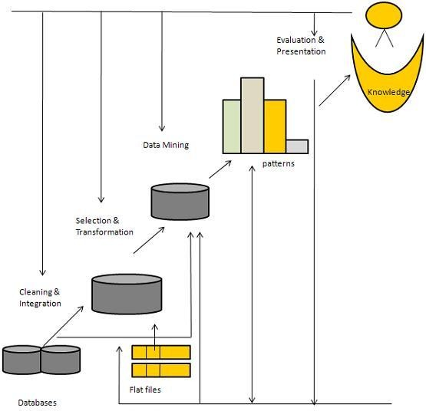
The following diagram shows the process of knowledge discovery process:

Slide 36
Data Cleaning in Data Mining
Data cleaning is a process to clean the dirty data. Data is mostly not clean. It means that most data can be incorrect due to a large number of reasons like due to hardware error/failure, network error or human error. So it is compulsory to clean the data before mining.

Slide 37
What is importance and benefits of data cleaning
1. Data Cleaning removes major errors.
2. Data Cleaning ensures happier customers, more sales, and more accurate decision.
3. Data Cleaning removes inconsistencies that are most likely occur when multiple sources of data are store into one data-set.
4. Data Cleaning make the data-set more efficient, more reliable and more accurate

Slide 38
Sources of Missing Values
There are many sources of missing data. Let’s see some major sources of missing data.
User forgot to fill the data in a field.
It can be a programming error.
Data can be lost when we transferring the data manually from a legacy database.

Slide 39
Dirty data | Examples
Incomplete data | salary=” ”
Inconsistent data | Age =”5 years”, Birthday =”06/06/1990″, Current Year =”2017″
Noisy data | Salary = “-5000”, Name = “123”
Intentional error | Sometimes applications a lot auto value to attribute. e.g some application put gender value as male by default. gender=”male”

Slide 40
How to Handle incomplete/Missing Data?
Ignore the tuple
Fill in the missing value manually
Fill the values automatically by
  Getting the attribute mean
  Getting the constant value if any constant value is there.
  Getting the most probable value by Bayesian formula or decision tree

Slide 41
How to Handle Noisy Data?
Binning
Regression
Clustering
Combined computer and human inspection.

Slide 42
What is Binning?
Binning is a technique in which first of all we sort the data and then partition the data into equal frequency bins.
Bin 1 2, 3, 6, 8
Bin 2 14,16,18,24
Bin 3 26,28,30,32

Slide 43
Types of binning:
There are many types of binning. Some of them are as follows;
Smooth by getting the bin means
Bin 1 4.75, 4.75, 4.75, 4.75
Bin 2 18,18,18,18
Bin 3 29,29,29,29
Smooth by getting the bin median
Smooth by getting the bin boundaries, etc.

Slide 44
Data Transformation in Data Mining
The data are transformed in ways that are ideal for mining the data. The data transformation involves steps that are:

Slide 45
1. Smoothing:
It is a process that is used to remove noise from the dataset using some algorithms It allows for highlighting important features present in the dataset. It helps in predicting the patterns. When collecting data, it can be manipulated to eliminate or reduce any variance or any other noise form.
The concept behind data smoothing is that it will be able to identify simple changes to help predict different trends and patterns. This serves as a help to analysts or traders who need to look at a lot of data which can often be difficult to digest for finding patterns that they wouldn’t see otherwise.

Slide 46
2. Aggregation:
Data collection or aggregation is the method of storing and presenting data in a summary format. The data may be obtained from multiple data sources to integrate these data sources into a data analysis description. This is a crucial step since the accuracy of data analysis insights is highly dependent on the quantity and quality of the data used. Gathering accurate data of high quality and a large enough quantity is necessary to produce relevant results.

Slide 47
The collection of data is useful for everything from decisions concerning financing or business strategy of the product, pricing, operations, and marketing strategies.
For example, Sales, data may be aggregated to compute monthly& annual total amounts.

Slide 48
3. Discretization:
It is a process of transforming continuous data into set of small intervals. Most Data Mining activities in the real world require continuous attributes. Yet many of the existing data mining frameworks are unable to handle these attributes.

Slide 49
Also, even if a data mining task can manage a continuous attribute, it can significantly improve its efficiency by replacing a constant quality attribute with its discrete values.
For example, (1-10, 11-20) (age:- young, middle age, senior).

Slide 50
4. Attribute Construction:
Where new attributes are created & applied to assist the mining process from the given set of attributes. This simplifies the original data & makes the mining more efficient.

Slide 51
5. Generalization:
It converts low-level data attributes to high-level data attributes using concept hierarchy. For Example Age initially in Numerical form (22, 25) is converted into categorical value (young, old).
For example, Categorical attributes, such as house addresses, may be generalized to higher-level definitions, such as town or country.

Slide 52
6. Normalization:
Data normalization involves converting all data variable into a given range.
Techniques that are used for normalization are:

Slide 53
Min-Max Normalization:This transforms the original data linearly.
Suppose that: min_A is the minima and max_A is the maxima of an attribute, P
We Have the Formula:
Where v is the value you want to plot in the new range.
v’ is the new value you get after normalizing the old value.

Slide 54
Suppose the minimum and maximum value for an attribute profit(P) are Rs. 10, 000 and Rs. 100, 000. We want to plot the profit in the range [0, 1]. Using min-max normalization the value of Rs. 20, 000 for attribute profit can be plotted to:

Slide 55


Slide 56
And hence, we get the value of v’ as 0.11

Slide 57
Z-Score Normalization:
z-score normalization (or zero-mean normalization) the values of an attribute (A), are normalized based on the mean of A and its standard deviation
A value, v, of attribute A is normalized to v’ by computing

Slide 59
For example:
Let mean of an attribute P = 60, 000, Standard Deviation = 10, 000, for the attribute P. Using z-score normalization, a value of 85000 for P can be transformed to:

Slide 61


Slide 62
And hence we get the value of v’ to be 2.5

Slide 63
Decimal Scaling:
It normalizes the values of an attribute by changing the position of their decimal points
The number of points by which the decimal point is moved can be determined by the absolute maximum value of attribute A.
A value, v, of attribute A is normalized to v’ by computing

Slide 64
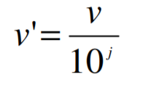

Slide 65
where j is the smallest integer such that Max(|v’|) < 1.
For example:
Suppose: Values of an attribute P varies from -99 to 99.
The maximum absolute value of P is 99.
For normalizing the values we divide the numbers by 100 (i.e., j = 2) or (number of integers in the largest number) so that values come out to be as 0.98, 0.97 and so on.

Slide 68
Outline of Lecture
Data Warehousing and Information Integration
Brief History of Data Warehousing
What is a Data Warehouse?
Types of Data and Their Uses
Data Warehouse Architectures
Issues in Data Warehousing

Slide 69

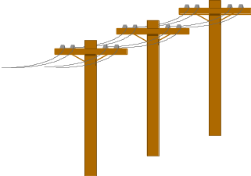


Problem: Heterogeneous Information Sources
“Heterogeneities are everywhere”
Personal
Databases
World
Wide
Web
Scientific Databases
Digital Libraries
Different interfaces
Different data representations
Duplicate and inconsistent information

Slide 70
Problem: Data Management in Large Enterprises
Vertical fragmentation of informational systems (vertical stove pipes)
Result of application (user)-driven development of operational systems
Sales Planning
Suppliers
Num. Control
Stock Mngmt
Debt Mngmt
Inventory
...
...
...
Sales Administration
Finance
Manufacturing
...

Slide 71


Goal: Unified Access to Data
Integration System
World
Wide
Web
Personal
Databases
Digital Libraries
Scientific Databases
Collects and combines information
Provides integrated view, uniform user interface
Supports sharing

Slide 72
The Traditional Research Approach
Query-driven (lazy, on-demand)
Clients
Integration System
Metadata
. . .
Wrapper
Wrapper
Wrapper
. . .
Source
Source
Source

Slide 73
Disadvantages of Query-Driven Approach
Delay in query processing
  Slow or unavailable information sources
  Complex filtering and integration
Inefficient and potentially expensive for frequent queries
Competes with local processing at sources
Hasn’t caught on in industry

Slide 74
The Warehousing Approach
Clients
Information integrated in advance
Stored in wh for direct querying and analysis
Data
Warehouse
Integration System
Metadata
. . .
Extractor/
Monitor
Extractor/
Monitor
Extractor/
Monitor
. . .
Source
Source
Source

Slide 75
Advantages of Warehousing Approach
High query performance
  But not necessarily most current information
Doesn’t interfere with local processing at sources
  Complex queries at warehouse
  OLTP at information sources
Information copied at warehouse
  Can modify, annotate, summarize, restructure, etc.
  Can store historical information
  Security, no auditing
Has caught on in industry

Slide 76
Not Either-Or Decision
Query-driven approach still better for
  Rapidly changing information
  Rapidly changing information sources
  Truly vast amounts of data from large numbers of sources
  Clients with unpredictable needs

Slide 77
Data Warehouse Evolution
Relational
Databases
Company
DWs
“Building the
DW”
Inmon (1992)
Data Replication
Tools
1960
1975
1980
1985
1990
1995
2000
Information-
Based
Management
“Prehistoric
Times”
“Middle
Ages”
Data
Revolution
TIME
PC’s and
Spreadsheets
End-user
Interfaces
1st DW
Article
DW
Confs.
Vendor DW
Frameworks

Slide 78
What is a Data Warehouse?
A Practitioners Viewpoint
“A data warehouse is simply a single, complete, and consistent store of data obtained from a variety of sources and made available to end users in a way they can understand and use it in a business context.”
-- Barry Devlin, IBM Consultant

Slide 79
A Data Warehouse is...
Stored collection of diverse data
  A solution to data integration problem
  Single repository of information
Subject-oriented
  Organized by subject, not by application
  Used for analysis, data mining, etc.
Optimized differently from transaction-oriented db
User interface aimed at executive

Slide 80
A Data Warehouse is... (continued)
Large volume of data (Gb, Tb)
Non-volatile
  Historical
  Time attributes are important
Updates infrequent
May be append-only
Examples
  All transactions ever at WalMart
  Complete client histories at insurance firm
  Stockbroker financial information and portfolios

Slide 81
Summary
Business
Information Guide
Business Information
Interface
Data
Warehouse
Data
Warehouse
Catalog
Data Warehouse
Population
Enterprise
Modeling
Operational Systems

Slide 82
Warehouse is a Specialized DB
Standard DB
Mostly updates
Many small transactions
Mb - Gb of data
Current snapshot
Index/hash on p.k.
Raw data
Thousands of users (e.g., clerical users)
Warehouse
Mostly reads
Queries are long and complex
Gb - Tb of data
History
Lots of scans
Summarized, reconciled data
Hundreds of users (e.g., decision-makers, analysts)

Slide 83
Warehousing and Industry
Warehousing is big business
  $2 billion in 1995
  $3.5 billion in early 1997
  Predicted: $8 billion in 1998 [Metagroup]
  The global data warehousing market size was valued at $21.18 billion in 2019, and is projected to reach $51.18 billion by 2028, growing at a CAGR of 10.7% from 2020 to 2028.
WalMart has largest warehouse
  900-CPU, 2,700 disk, 23 TB Teradata system
  ~7TB in warehouse
  40-50GB per day

Slide 84
Top 10 Data Warehouse Software
Amazon Redshift.
Snowflake.
Google Cloud.
Vertica.
IBM Netezza Performance Server.
IBM Db2.
Databricks Lakehouse Platform.
Microsoft.

Slide 85
Types of Data
Business Data - represents meaning
  Real-time data (ultimate source of all business data)
  Reconciled data
  Derived data
Metadata - describes meaning
  Build-time metadata
  Control metadata
  Usage metadata
Data as a product* - intrinsic meaning
  Produced and stored for its own intrinsic value
  e.g., the contents of a text-book

Slide 86
Data Warehouse Architectures: Conceptual View
Operational
systems
Informational
systems
Single-layer
  Every data element is stored once only
  Virtual warehouse
Two-layer
  Real-time + derived data
  Most commonly used approach in
  industry today
“Real-time data”
Operational
systems
Informational
systems
Derived Data
Real-time data

Slide 87
Three-layer Architecture: Conceptual View
Transformation of real-time data to derived data really requires two steps
Operational
systems
Informational
systems
View level
“Particular informational
needs”
Derived Data
Reconciled Data
Physical Implementation
of the Data Warehouse
Real-time data

Slide 88
Data Warehousing: Two Distinct Issues
(1) How to get information into warehouse
“Data warehousing”
(2) What to do with data once it’s in warehouse
“Warehouse DBMS”
Both rich research areas
Industry has focused on (2)

Slide 89
Issues in Data Warehousing
Warehouse Design
Extraction
  Wrappers, monitors (change detectors)
Integration
  Cleansing & merging
Warehousing specification & Maintenance
Optimizations
Miscellaneous (e.g., evolution)

Slide 90
Data Extraction
Source types
  Relational, flat file, WWW, etc.
How to get data out?
  Replication tool
  Dump file
  Create report
  ODBC or third-party “wrappers”

Slide 91
Warehouse Architecture
Client
Client
Query & Analysis
Warehouse
Integrator
Metadata
Extractor/
Monitor
Extractor/
Monitor
Extractor/
Monitor
Source
Source
Source
...

Slide 92
Issues (1)
Warehouse uses relational data model or multi-dimensional data model (e.g., data cube)
On the other hand, source types
  Relational, OO, hierarchical, legacy
  Semistructured: flat file, WWW
How do we get the data out?

Slide 93
Issues (2)
Warehouse must be kept current in light of changes to underlying sources
How do we detect updates in sources?

Slide 94
Wrapper
Converts data and queries from one data model to another
Data
Model
A
Queries
Data
Model
B
Data
Extends query capabilities for sources with limited capabilities
Queries
Wrapper
Source

Slide 95

Wrapper Generation
Solution 1: Hard code for each source
Solution 2: Automatic wrapper generation
Wrapper
Wrapper
Generator
Definition

Slide 96
Wrapper Approach
Source-specific adapter (a.k.a. wrapper, translator)
“Thickness” of adapter depends on source
  Data model used (e.g. rel. schema vs. unstructured)
  Interface (i.e., query language, API)
  Active capabilities (i.e., triggers)
  Degree of autonomy (e.g., same owner & modifiable vs. controlled by external entity & no changes possible)
  Cooperation (e.g., friendly vs. uncooperative)

Slide 97
Routine When...
Many tools for dealing with “standard situations”
  Standard sources with full/many capabilities
    e.g., most commercial DBMSs, all ODBC-compliant sources
  Standard interactions
    e.g., pass-through queries, extraction from rel. tables, replication
  Cooperative sources or sources under our control
Tools
  Replication tools, ODBC, report writers, third-party “wrappers”

Slide 98
Not So Routine When...
“Non-standard situations”
  Unstructured or semistructured sources with little or no explicit schema
  Uncooperative sources
  Sources with limited capabilities (e.g., legacy sources, WWW)
Few commercial tools
Mostly research

Slide 99
Data Transformations
Convert data to uniform format
  Byte ordering, string termination
  Internal layout
Remove, add & reorder attributes
  Add key
  Add data to get history
Sort tuples

Slide 100
Monitors
Goal: Detect changes of interest and propagate to integrator
How?
  Triggers
  Replication server
  Log sniffer
  Compare query results
  Compare snapshots/dumps

Slide 101
Data Integration
Receive data (changes) from multiple wrappers/monitors and integrate into warehouse
Rule-based
Actions
  Resolve inconsistencies
  Eliminate duplicates
  Integrate into warehouse (may not be empty)
  Summarize data
  Fetch more data from sources (wh updates)
  etc.

Slide 102
Data Cleansing
Find (& remove) duplicate tuples
  e.g., Jane Doe vs. Jane Q. Doe
Detect inconsistent, wrong data
  Attribute values that don’t match
Patch missing, unreadable data
Notify sources of errors found

Slide 103
Data Mining
Data mining is the process of discovering predictive information from the analysis of large databases. For a data scientist, data mining can be a vague and daunting task – it requires a diverse set of skills and knowledge of many data mining techniques to take raw data and successfully get insights from it.

Slide 104
We will want to understand the foundations of statistics and different programming languages that can help with data mining at scale.
one of the most widely used data mining tools – from cleaning and data organization to applying machine learning algorithms

Slide 105
A data mining definition
The desired outcome from data mining is to create a model from a given data set that can have its insights generalized to similar data sets. A real-world example of a successful data mining application can be seen in automatic fraud detection from banks and credit institutions.

Slide 106
Your bank likely has a policy to alert you if they detect any suspicious activity on your account – such as repeated ATM withdrawals or large purchases in a state outside of your registered residence. How does this relate to data mining? Data scientists created this system by applying algorithms to classify and predict whether a transaction is fraudulent by comparing it against a historical pattern of fraudulent and non-fraudulent charges. The model “knows” that if you live in San Diego, California, it’s highly likely that the thousand dollar purchases charged to a scarcely populated Russian province were not legitimate.

Slide 107
That is just one of a number of the powerful applications of data mining. Other applications of data mining include genomic sequencing, social network analysis, or crime imaging – but the most common use case is for analyzing aspects of the consumer life cycle. Companies use data mining to discover consumer preferences, classify different consumers based on their purchasing activity, and determine what makes for a well-paying customer – information that can have profound effects on improving revenue streams and cutting costs.

Slide 108
some data mining techniques?
Regression – Estimating the relationships between variables by optimizing the reduction of error

Slide 109
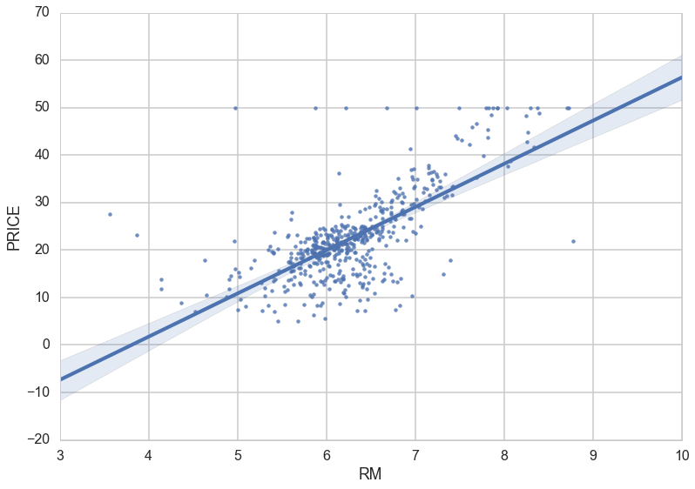
Regression--- An example of a scatterplot with a fitted linear regression model.

Slide 110
Classification – Identifying what category an object belongs to. An example is classifying email as spam or legitimate, or looking at a person’s credit score and approving or denying a loan request.
Cluster Analysis – Finding natural groupings of data objects based upon the known characteristics of that data. An example could be seen in marketing, where analysis can reveal customer groupings with unique behavior – which could be applied in business strategy decisions.

Slide 111
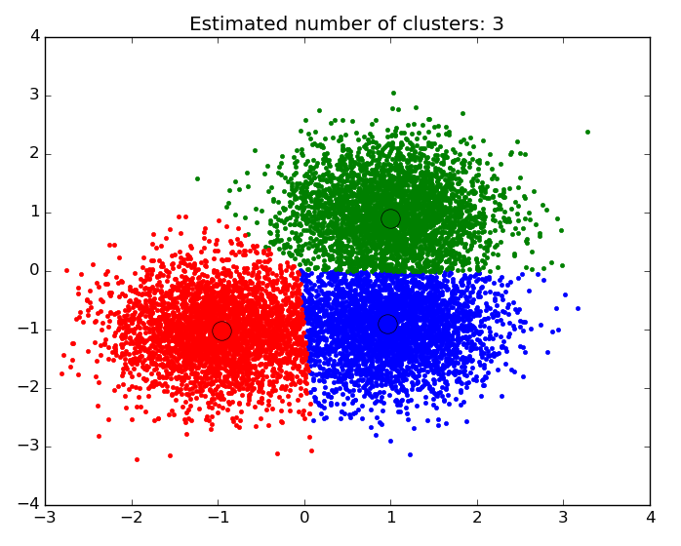
An example of a scatter plot with the data segmented and colored by cluster

Slide 112
Association and Correlation Analysis – Looking to see if there are unique relationships between variables that are not immediately obvious. An example would be the famous case of beer and diapers: men who bought diapers at the end of the week were much more likely to buy beer, so stores placed them close to each other to increase sales.
Outlier analysis – Examining outliers to examine potential causes and reasons for said outliers. An example of which is the use of outlier analysis in fraud detection, and trying to determine if a pattern of behavior outside the norm is fraud or not.

